Slide 1
Bacchus Winery
Trevor Michaels, Jessica Hall, Kendall Taylor, Stefan Brenner

Slide 2
Case Study
Stan and Davis Bacchus are taking over their father’s winery upon his retirement. They have decided they want to implement new methods to help improve their products and services.
During the turnover, they decided to keep all existing personnel to minimize change in staff and employment. They currently employ a finance manager (Janet Collins), a marketing manager (Roz Murphy) and her assistant (Bob Ulrich), a production manager (Henry Doyle), a distribution manager (Maria Costanza), and 20 production line employees.
They currently grow grapes to make 4 different kinds of wine. Supplies are ordered through 3 different suppliers and are looking for an efficient way to manage supply and wine inventory and supply orders.
Stan and Davis are also interested in a simple way to manage employee work time and scheduling.

Slide 3
Business Rules and Assumptions
•Every supply needed has a designated supplier
•Multiple supply items can be requested from a supplier in one order
•Each order must have an estimated delivery date
•Each supply order includes one tracking number
•Employee hours are tracked and recorded daily
•Each wine order can have one distributor
•Distributors can order multiple products in one order

Slide 4
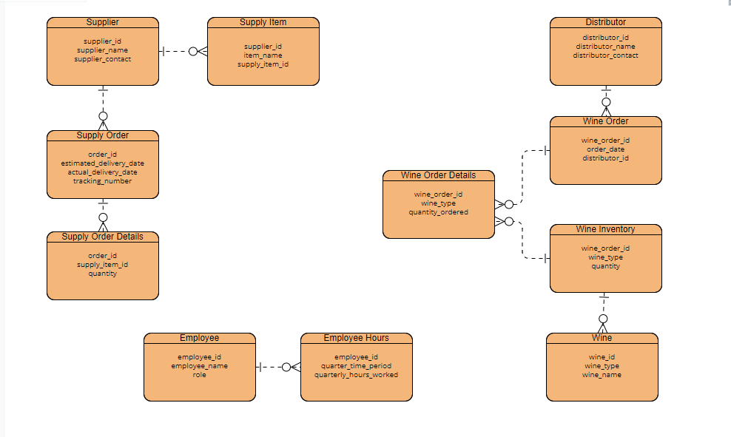
Finalized ERD

Slide 5
Reports
Report #1: Employee Time Card
Purpose: To track employee hours and simplify employee scheduling
Query: Calculates employee hours worked
Report #2: Wine Orders
Purpose: To track which wines have been bought most frequently
Query: Calculates wine quantity purchased
Report #3: Supply Inventory
Purpose: To track supply inventory and help plan future orders
Query: Calculates the amount of each supply on hand
Report #4: Wine Inventory
Purpose: To track wine inventory and plan for production schedules
Query: Calculates the amount of each wine in inventory
Report #5: Staff Quarterly Hours
Purpose: To track staff hours on a quarterly basis and manage payroll
Query: Calculates the number of hours that each employee works per quarter

Slide 6
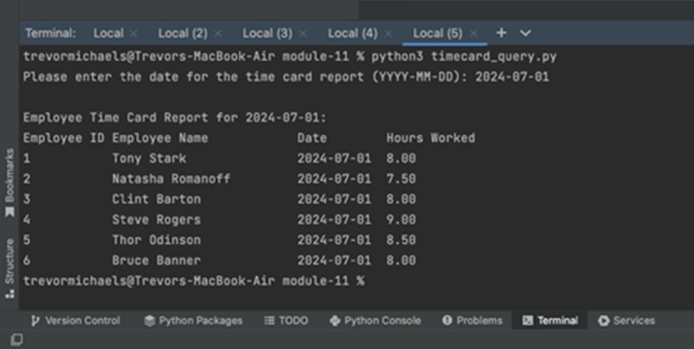
Report #1 – Employee Time Card
During the turnover of Bacchus Winery, Stan and Davis Bacchus have decided to keep all existing personnel in place.
Henry Doyle manages the production line and the 20 employees that work in line. The Bacchus’ need an easy way to retrieve hours worked for their employees for each day.
The employee timecard report will tell how many hours each employee has worked during a specific day. This will help to manage schedules and keep track of hours worked for payroll.
SELECT Employee.employee_id, Employee.employee_name, EmployeeHours.date, EmployeeHours.hours_worked
FROM Employee
JOIN EmployeeHours ON Employee.employee_id = EmployeeHours.employee_id
WHERE EmployeeHours.date = %s
ORDER BY Employee.employee_id;

Slide 7
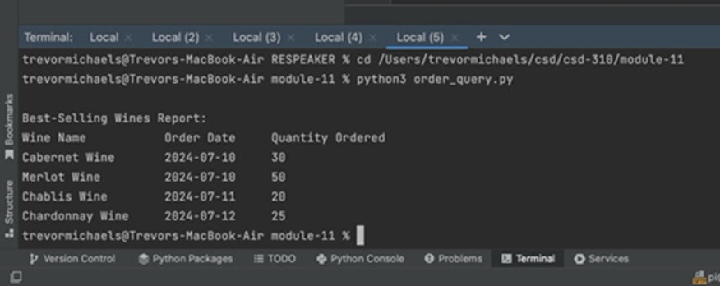
Report #2 – Wine Orders
The Bacchus’ are also looking for a way to record what wines are best-selling.
They need a report that will show wine orders, the type of wine, and the quantity of each wine they are selling in these orders.
This report will help them to keep track of what wines are being purchased more frequently and which wines are not selling as well.
SELECT Wine.wine_name, WineOrder.order_date, WineOrderDetails.quantity
FROM Wine
JOIN WineOrderDetails ON Wine.wine_type = WineOrderDetails.wine_type
JOIN WineOrder ON WineOrder.wine_order_id = WineOrderDetails.wine_order_id
ORDER BY WineOrder.order_date;

Slide 8
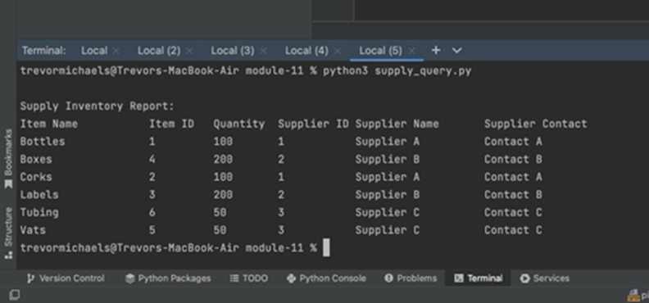
Report #3 – Supply Inventory
The Bacchus Winery needs a simple and efficient way to keep track of their supplies in stock to better prepare for supply orders.
The Supply inventory report will help them to know what they are running low on ahead of time and the amount of each supply they currently have.
This report will also help to keep track of which supplier they get each supply from to simplify future orders.
SELECT si.item_name, si.supply_item_id, sod.quantity, s.supplier_id, s.supplier_name, s.supplier_contact FROM SupplyItem si JOIN SupplyOrderDetails sod ON si.supply_item_id = sod.supply_item_id JOIN Supplier s ON si.supplier_id = s.supplier_id ORDER BY si.item_name;

Slide 9
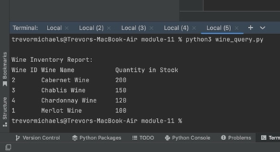
Report #4 – Wine Inventory
The wine inventory report will help Bacchus Winery to keep records of the quantity of each wine they currently have in stock.
They can use this information to form daily production plans and weekly goals for the production line.
This will help to ensure they always have the necessary wines in stock and ready for orders.
SELECT w.wine_id, w.wine_name, wi.quantity FROM Wine w JOIN WineInventory wi ON w.wine_id = wi.wine_id ORDER BY w.wine_name;

Slide 10
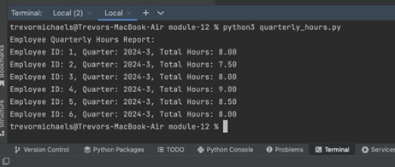
Report #5 – Employee Quarterly Hours
The Bacchus Winery needs a way to calculate how many hours each employee has worked during a quarter
They can use this information to schedule and record staff attendance and manage payroll.

